Slide 1
DATA ANALYSIS FOR E-COMMERCE CUSTOMER RETENTION
Presentation by: Nirav Mehta

Slide 2
E-retail factors for Customer Retention.
Customer satisfaction has emerged as one of the most important factors that guarantee the success of online store; it has been posited as a key stimulant of purchase, repurchase intentions and customer loyalty. A comprehensive review of the literature, theories and models have been carried out to propose the models for customer activation and customer retention. Using the Data analytics skills we are going to analysis the given dataset to understand major factors that contributed to the success of an e-commerce store which is also matching as said in the above theory.

Slide 3
Exploratory Data Analysis
Univariate Analysis
Univariate analysis is the simplest form of analyzing data. “Uni” means “one”, so in other words your data has only one variable.
Multivariate Analysis
Multivariate analysis is a set of statistical techniques used for analysis of data that contain more than one variable.
Correlation of Dataset
Correlation is used to test relationships between quantitative variables or categorical variables.
Correlation with Target variable
Correlation with the target variable to know how the data is related.
Conclusion
Summary with the conclusion of all the analysis

Slide 4
Univariate Analysis
Univariate analysis is the simplest form of analyzing data. “Uni” means “one”, so in other words your data has only one variable.

Slide 5
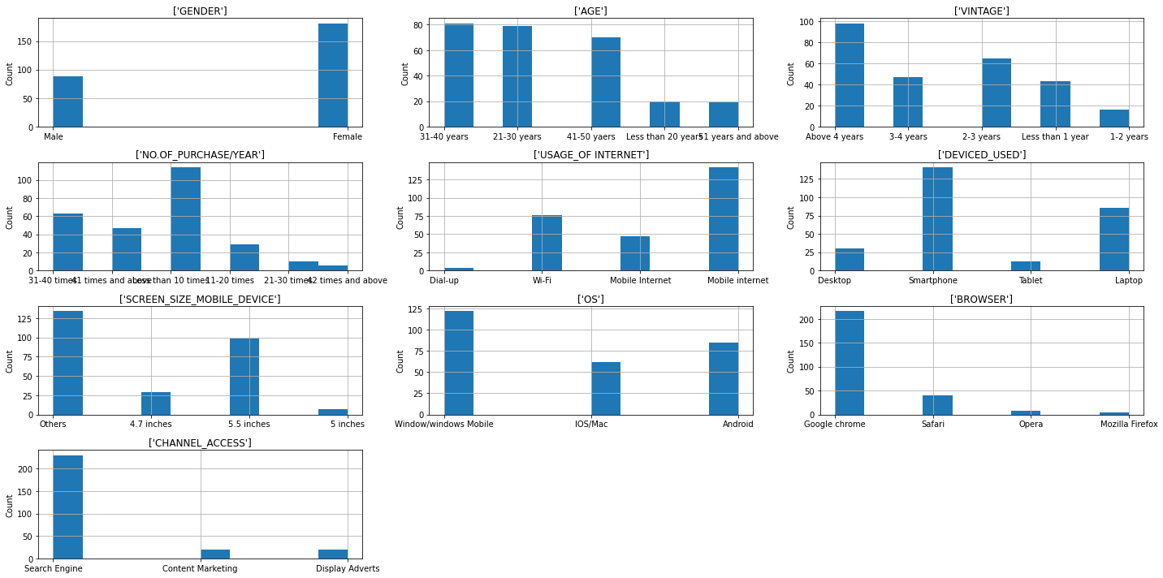
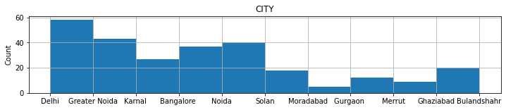
Customer and Customer usage details columns

Slide 6
Key observations
We can observe that the Female users are higher in number comparatively and highest population of the users are between 21-40 years of age and with the vintage above 4 years.
Highest No of purchase done/year is above 10.
Customers mostly use mobile internet in smartphones and all or any type of screen size.
Operating system is 'Windows' mostly on PC and 'Android' on smart phones and customer uses Chrome and search engines.
So from above we can say that Female users mostly from Delhi aged between 20-40 years with vintage above 4 years of online shopping shop more with the use of android based smart phones.

Slide 7
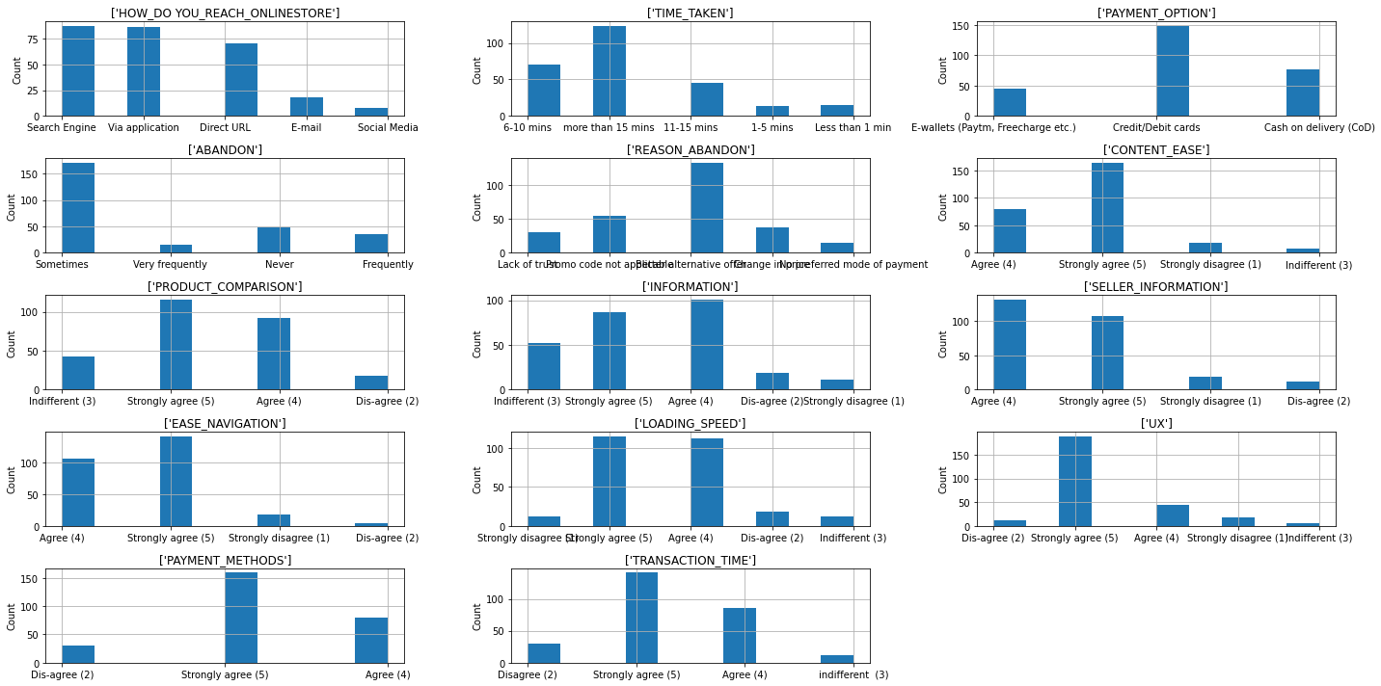
Merchant Website/Application details columns

Slide 8
Key observations
Highest population reaches online by 'Search Engine' like google.com time spend on a purchase is more than 15 mins and people rarely abandon purchasing post entering the online store.
Most of the time highest reason for stopping transaction is better alternative offers from other merchants.
Payment options are mostly being Credit/Debit cards followed by COD.
Content information, Ease of navigation, product and vendor information clarity, site loading speed most of the population are between agree and strongly agree.
We also have mostly positive feedback with 'UX', 'Payment_options' and time taken for the transaction.
So from above we can say people who are actively using online store are happy with the content of the site details and User experience.

Slide 9
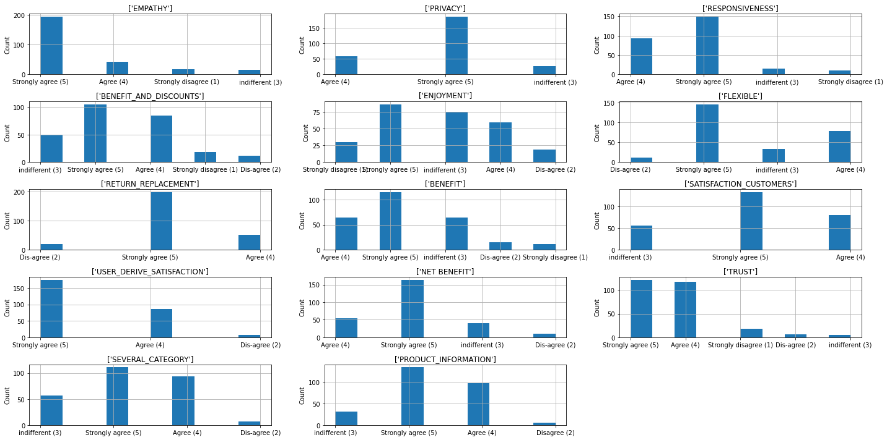
Merchant Customer Success details columns

Slide 10
Key observations
From above we can see the major population of the people have voted for ‘Strongly agree' on ,Empathy, Privacy, Responsiveness, Benefits and Discounts, enjoyment, Flexibility, Return and replacement Grantee, Benefits, overall Customer satisfaction for services, Trust on the product, Product information in detailed, net benefits, Serval categories.
So from the observation we can say that majority of the customers are happy with the services that they get from the e-commerce website, but however customer also voted for disagree majorly on benefits and discount and Enjoyment. So to attract those customers E-Commerce merchant can also put-up persona based offers.

Slide 11
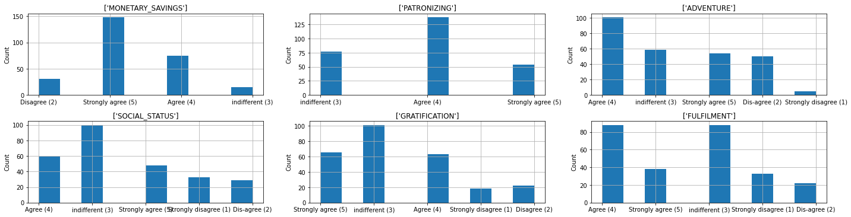
Merchant Customer Gratification details columns:

Slide 12
Key observations
Customer have voted strongly agree and agree for Monetary Savings, adventure and fulfillment.
Customer have voted indifferent and agree to social status, patronizing, gratification.
These observation says that using the E-commerce website customers doesn't agree that social status, patronizing, gratification are improved but however the Monetary Savings, adventure and fulfillment of the purchase will be a guaranteed.

Slide 13
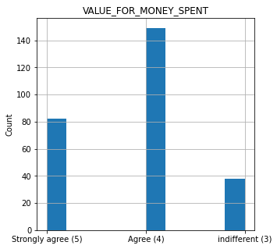
Customer Hedonic value column

Slide 14
Key observations
Most of the Customers agrees with the hedonic value that the Ecommerce gives the customer and nearly half of the population declares they strongly agree.

Slide 15
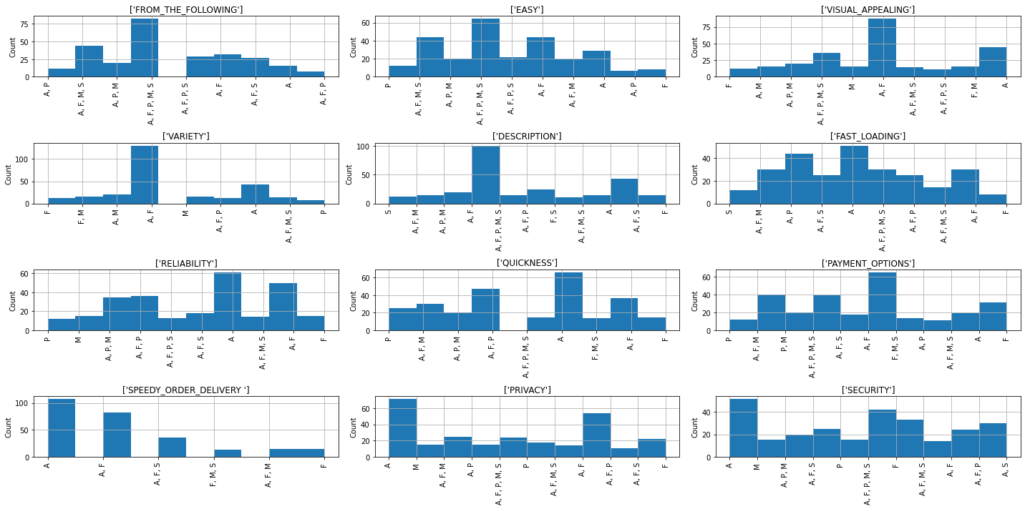
Customers Survey columns

Slide 16
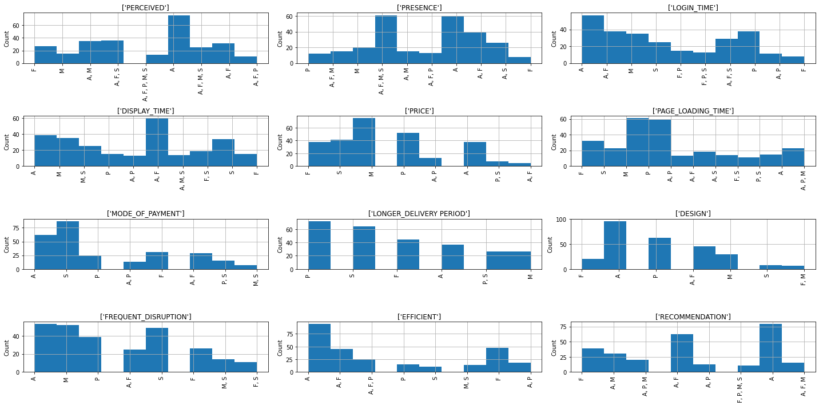
Customers Survey columns

Slide 17
Key observations
The observation says most of the people have voted Amazon at the top followed by Flipkart, Myntra, Snapdeal, Paytm for (EASY, VISUAL_APPEALING, PAYMENT_OPTIONS, SPEEDY_ORDER_DELIVERY, PRIVACY, SECURITY, LOGIN_TIME,DISPLAY_TIME, PRICE PAGE_LOADING_TIME, MODE_OF_PAYMENT, LONGER_DELIVERY, PERIOD, DESIGN, FREQUENT_DISRUPTION, EFFICIENT, RECOMMENDATION)
This says People enjoys using Amazon which tops all the category
The top 3 E-commerce vendors in India as per customer voting is Amazon, Flipkart, Myntra
Snapdeal and Paytm being the worst in delivery period.

Slide 18
Multivariate Analysis
Multivariate statistics is a subdivision of statistics encompassing the simultaneous observation and analysis of more than one outcome variable.

Slide 19
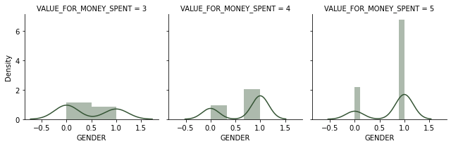
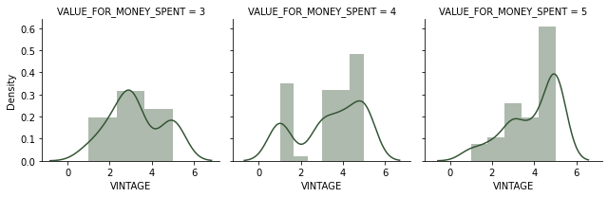
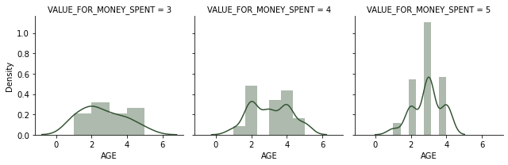
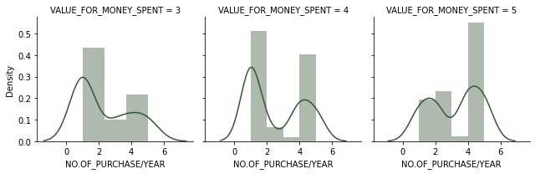
Customer Details Vs Hedonic Value

Slide 20
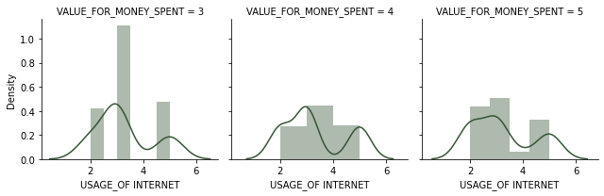
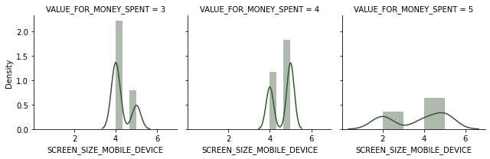
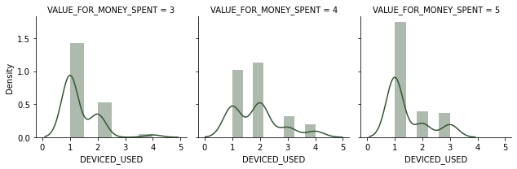
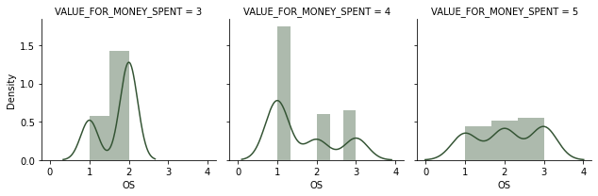
Customer Details Vs Hedonic Value

Slide 21
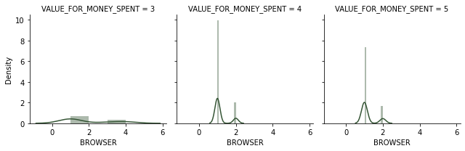
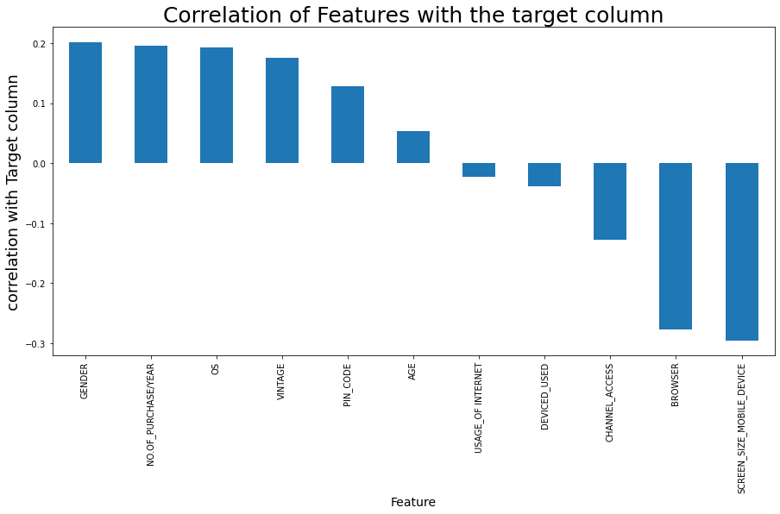
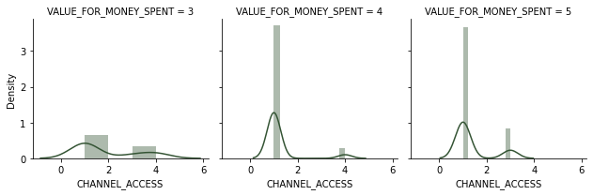
Customer Details Vs Hedonic Value

Slide 22
Key observations
In Gender we observe 0 - Male 1 - Female, the highest population voted for Agree and strongly Agree.
In AGE(20-40), Vintage above 4 years and most of NO.OF_PURCHASE/YEAR (above 10) users have voted for Strongly Agree.
SCREEN_SIZE_MOBILE_DEVICE , BROWSER have given negative reviews/others.
Usage of Internet, DEVICED_USED, OS, CHANNEL_ACCESS, voted customers have voted randomly for all categories in 'VALUE_FOR_MONEY_SPENT'.
Snapdeal and Paytm being the worst in delivery period.
From above we understand that people who are using the E-Commerce website more are strongly agreeing to the fact that its value for money. And these customers are not dependent on Usage of Internet, DEVICED_USED, SCREEN_SIZE_MOBILE_DEVICE, OS, BROWSER, CHANNEL_ACCESS.

Slide 23
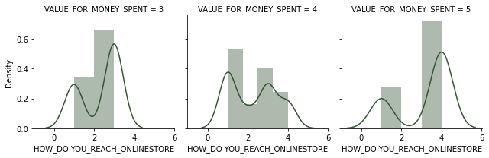
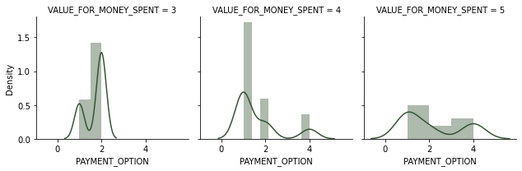
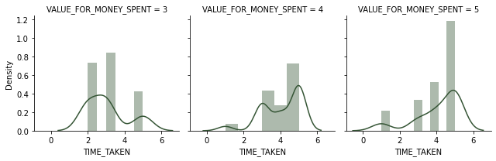
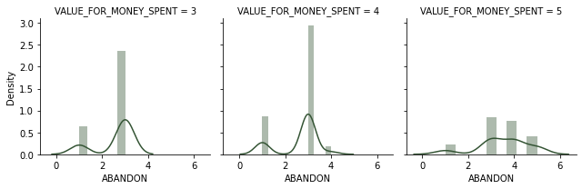
Details Vs Hedonic Value

Slide 24
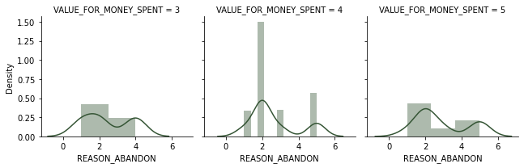
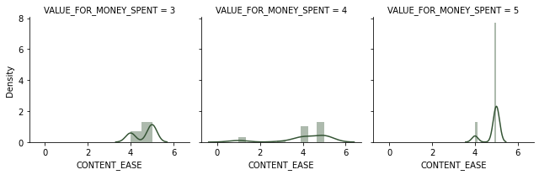
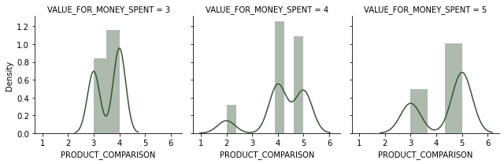
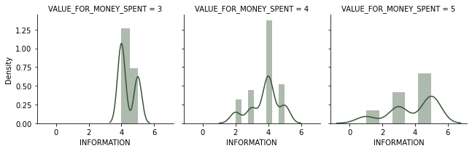
Details Vs Hedonic Value

Slide 25
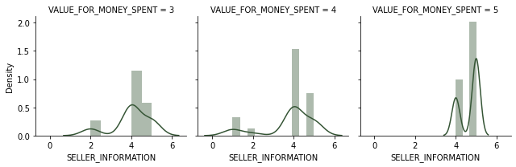
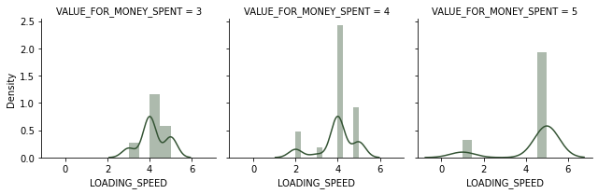
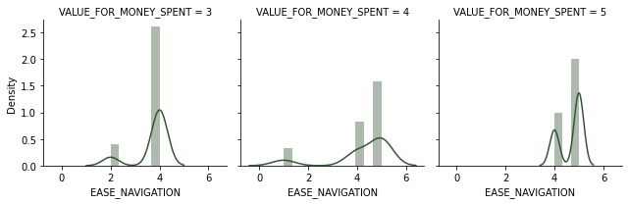
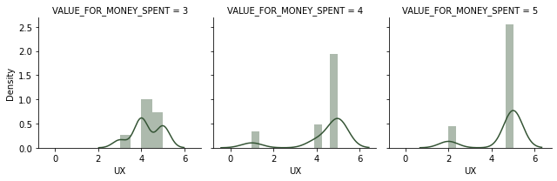
Details Vs Hedonic Value

Slide 26
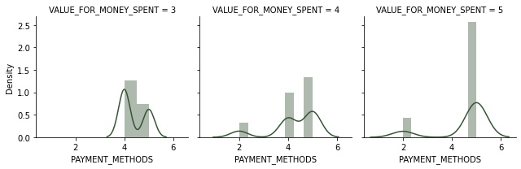
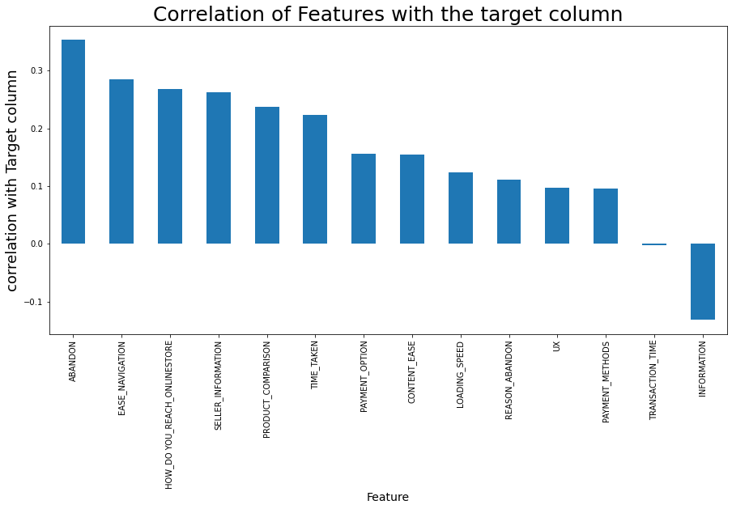
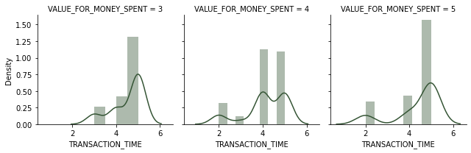
Details Vs Hedonic Value

Slide 27
Key observations
People who voted for HOW_DO YOU REACH ONLINE, SELLER INFORMATION, PRODUCT COMPARISON, TIME_TAKEN, PAYMENT_OPTIONS, CONTANT EASE, LODING_SPEED, UX, REASON_ABANDON, PAYMENT_METHOD, TRANSACTION TIME voted for almost all the values in values spent for money.
ABANDON, EASE OF NAVIGATION voted customers have voted mostly Strongly Agree for Value For Money spent.
To summarize, people are not interested in facilities or the information provided by the E-commerce merchant but those whose are interested in knowing about good deals and abandoning one-site and goes to another gives feed back as value for money.

Slide 28
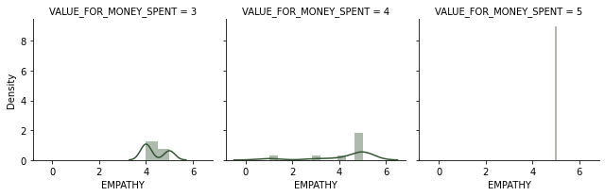
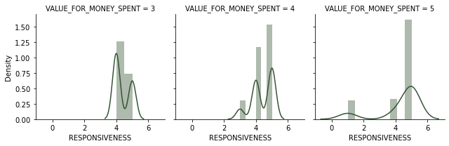
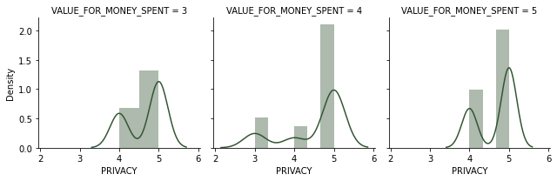
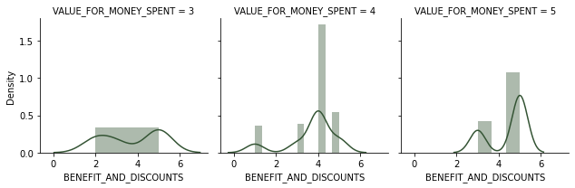
Customer Success Vs Hedonic Value

Slide 29
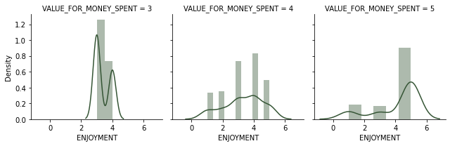
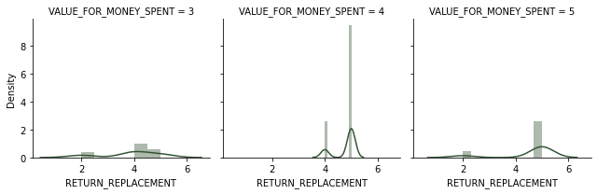
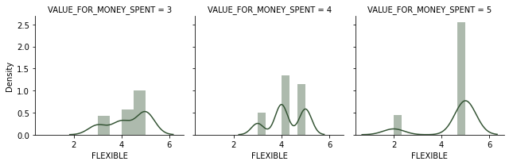
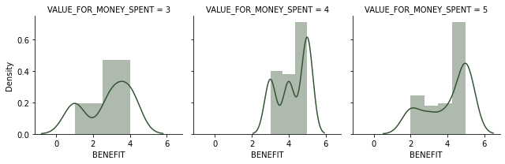
Customer Success Vs Hedonic Value

Slide 30
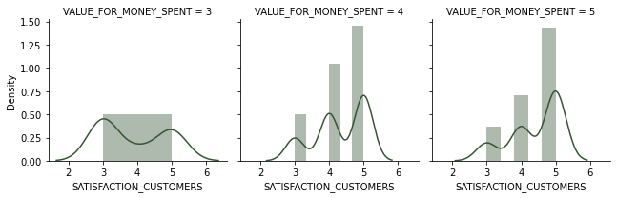
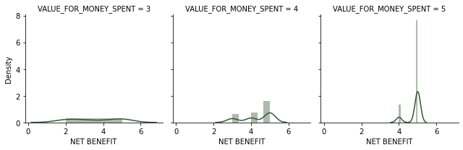
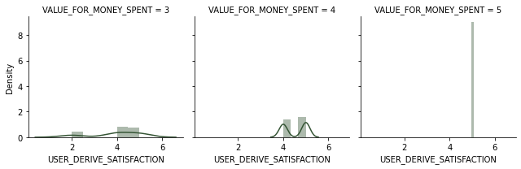
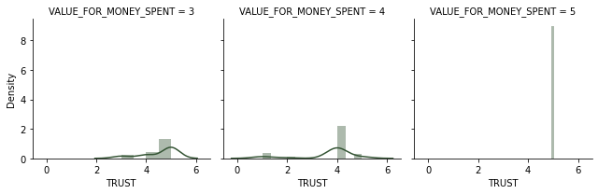
Customer Success Vs Hedonic Value

Slide 31
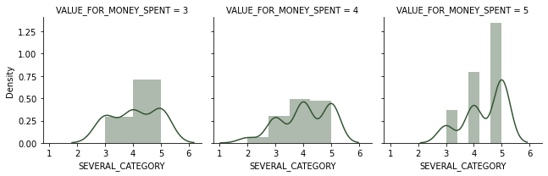
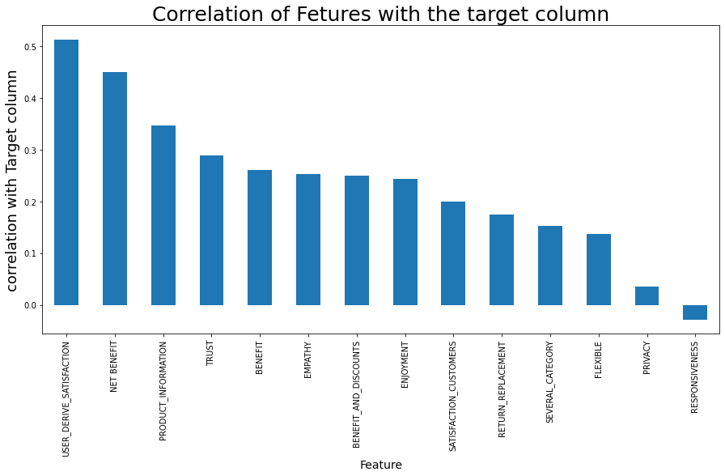
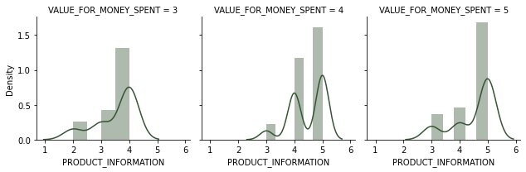
Customer Success Vs Hedonic Value

Slide 32
Key observations
USER_DERIVE_SATISFACTION, NET BENEFIT, PRODUCT_INFORMATION, TRUST, BENEFIT, EMPATHY, BENEFIT_AND_DISCOUNTS, ENJOYMENT voted customers have voted mostly agree for value for money spent.
From above we can understand customer will interested in E-Commerce when the customer is valued and pleased with the product, customer service and product purchased.

Slide 33
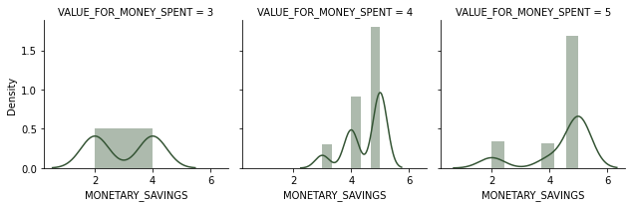



Customer Gratification Vs Hedonic Value

Slide 34



Customer Gratification Vs Hedonic Value

Slide 35
Key observations
GRATIFICATION, MONETARY_SAVINGS customers have voted for strongly agree in VALUE_FOR_MONEY_SPENT.
In PATRONIZING, ADVENTURE, FULFILMENT, SOCIAL_STATUS customer voted for all the Fields more are less equally.
The above observation says that the customer with good gratification and monetary savings tends to give feedback as value for money spend.

Slide 36

Customer Survey.
Amazon have most of the votes in all the parameters followed by Flipkart and Myntra.

Slide 37
Correlation of Dataset
We will observe the correlation of the data as per data in the data frame split. And Explanation at the last.

Slide 38

Correlation of Dataset

Slide 39

Correlation of Dataset

Slide 40

Correlation of Dataset

Slide 41

Correlation of Dataset

Slide 42

Correlation of Dataset

Slide 43
Key observations
From all the above observations we can derive the following points.
DEVISE_USED, OS, SCREEN_SIZE, WEB BROWSER, usage will directly related to each other which will also affect the usage of internet or e commerce application or website.
CONTENT_EASE, PRODUCT_COMPARISON, INFORMATION, SELLER_INFORMATION, EASE_NAVIGATION, LODING_SPEED, UX, TRANSACTION_TIME are more correlated to each other which will also affect the usage of internet or e commerce application or website.
Customer satisfaction and customer care with customer success directly affect the usage. Happy customers tends to purchase again.

Slide 44

Correlation of Dataset

Slide 45

Correlation of Dataset

Slide 46
Key observations
EFFICIENT, SPEEDY_ORDER_DELIVERY, PAGELODING, PAYMENT_OPTIONS, RECOMENDATION, LOGIN TIME, PRICE Directly affect the Value for money spent.
These observation says that customers are more interested in faster delivery ease of access product details over other factors which also makes the customers to purchase again from the same vendor.

Slide 47

SUMMARY

Slide 48
SUMMARY
The ease of usage of internet which includes the device used browser and internet the attractiveness of the web application/mobile application with convenience of ordering the product along with the Customer Support with Gratification makes a customer to be a repeated user.
The Customer Gratification that can be increased to make the customer feel that he is valued which directly increases the repeated usage.

Slide 49
CONCLUSION
E-commerce has transformed the way business is done in India. The Indian E-commerce market is expected to grow to US dollars 200 billion by 2026 from US dollars 38.5 billion as of 2021. Much of the growth for the industry has been triggered by an increase in internet and smartphone penetration, in such a market a customer can be a repeated user in depending on the factors as seen above and these factors are summarized into two such as Hedonic value and Utilitarian value. Improvement on these factors a Organization will be a leader in E-Commerce business in India.

